Slide 1
WIA1005 Network Technology Foundation
Chapter 5
IPv4

Slide 2
Contents
IPv4
Subnetting

Slide 3
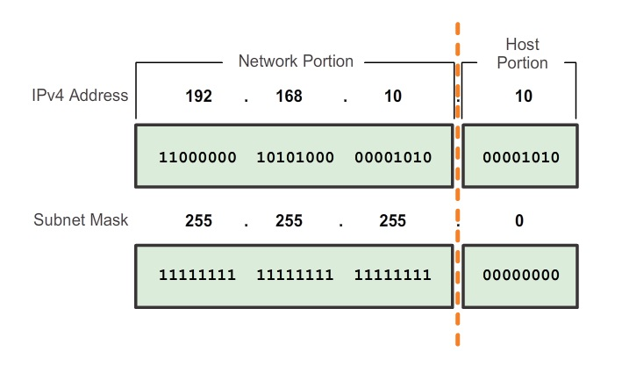
IPv4
IPv4 consists of 32-bits. A.B.C.D (0-255)
Within the 32-bit, a portion of the bits makes up the network and a portion of the bits makes up the host.

Slide 4
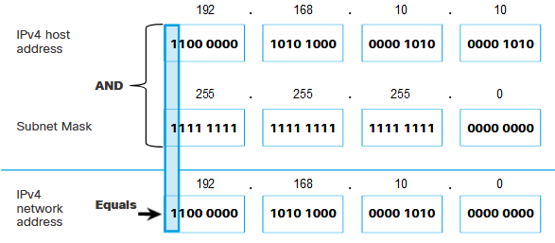
IPv4
IPv4 subnet mask is used to differentiate the network portion from the host portion of an IPv4 address.
When an IPv4 address is assigned to a device, the subnet mask is used to determine the network address of the device.
The actual process used to identify the network portion and host portion is called ANDing.

Slide 5
IPv4
Within each network are three types of IP addresses:
  Network address
  Host addresses
  Broadcast address
Network Address
  The network address is a standard way to refer to a network. It has the same subnet mask (network bit).
  It is located on the same broadcast domain as other hosts with the same network address.

Slide 6
IPv4
Host Address
  The unique address that is assigned to the end device. In IPv4, the host address is the addresses in between the network address and the broadcast address. (first host and last host)
Broadcast Address
  The IPv4 broadcast address is a special address for each network that allows communication to all the hosts in that network.
  The broadcast address uses the highest address in the network range. This is the address in which the bits in the host portion are all 1s.

Slide 7
IPv4
IPv4 host addresses are unicast addresses and are in the address range of 0.0.0.0 to 223.255.255.255.
IPv4 has a block of addresses reserved for addressing multicast groups. This address range is 224.0.0.0 to 239.255.255.255.
The multicast address range is subdivided into different types of addresses: 224.0.0.0 to 224.0.0.255 are reserved link local addresses, and the globally scoped addresses are 224.0.1.0 to 238.255.255.255.

Slide 8
IPv4
Private addresses are defined in RFC 1918 that are used in private networks. Hosts that do not require access to the Internet can use private addresses. However within the private network, hosts still require unique IP addresses within the private space.
The private address blocks are:
  10.0.0.0 to 10.255.255.255 (10.0.0.0/8)
  172.16.0.0 to 172.31.255.255 (172.16.0.0/12)
  192.168.0.0 to 192.168.255.255 (192.168.0.0/16)
The vast majority of the addresses in the IPv4 unicast host range are public addresses. These addresses are designed to be used in the hosts that are publicly accessible from the Internet.

Slide 9
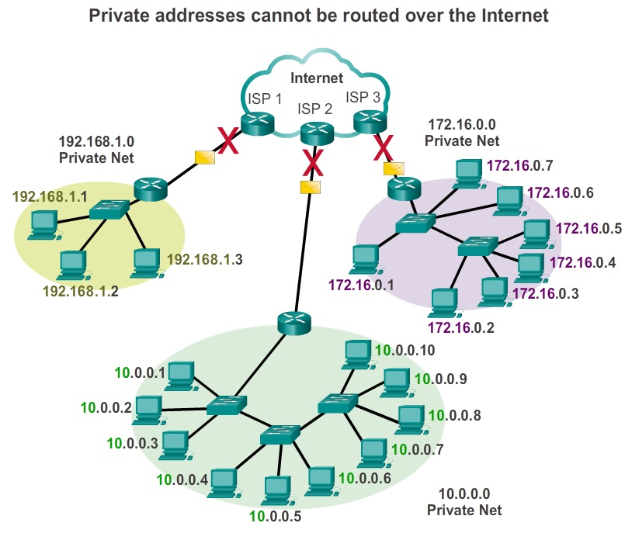
IPv4

Slide 10
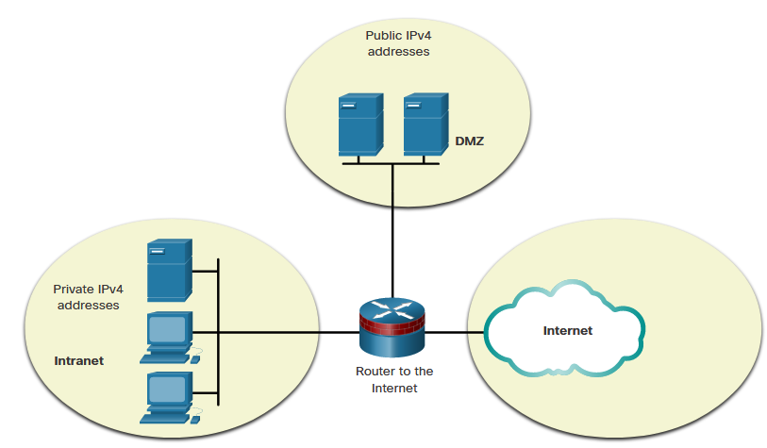
IPv4

Slide 11
IPv4
IPv4 loopback address 127.0.0.1 is a special address that hosts use to direct traffic to themselves. The loopback address creates a shortcut method for TCP/IP applications and services that run on the same device to communicate with one another.
IPv4 addresses in the address block 169.254.0.0 to 169.254.255.255 (169.254.0.0/16) are designated as link-local addresses. These addresses can be automatically assigned to the local host by the operating system in environments where no IP configuration is available.

Slide 12
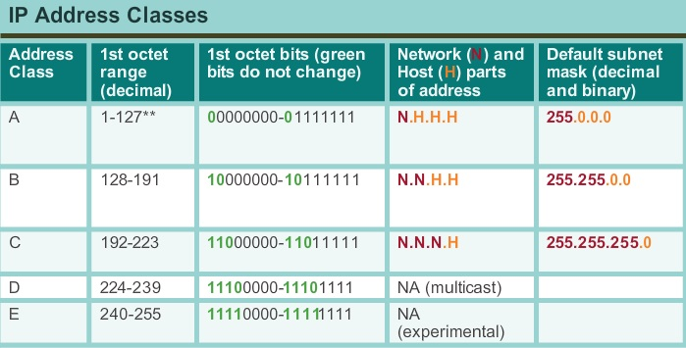
IPv4
Classful addressing grouped the unicast ranges into specific sizes called class A, class B, and class C addresses. It also defined class D (multicast) and class E (experimental).

Slide 13
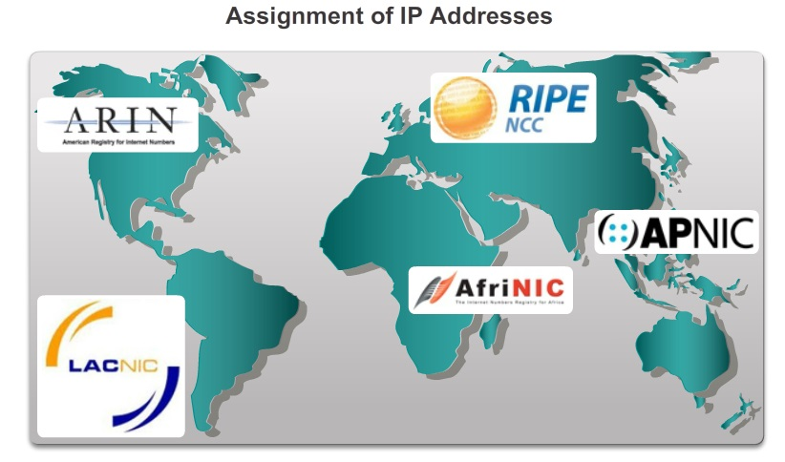
IPv4

Slide 14
Subnetting
A large broadcast domain is a network that connects many hosts.
A problem with a large broadcast domain is that these hosts can generate excessive broadcasts and negatively affect the network. This results in slow network operations due to the significant amount of traffic it can cause, and slow device operations because a device must accept and process each broadcast packet.
The solution is to reduce the size of the network to create smaller broadcast domains in a process called subnetting.
These smaller network spaces are called subnets.

Slide 15
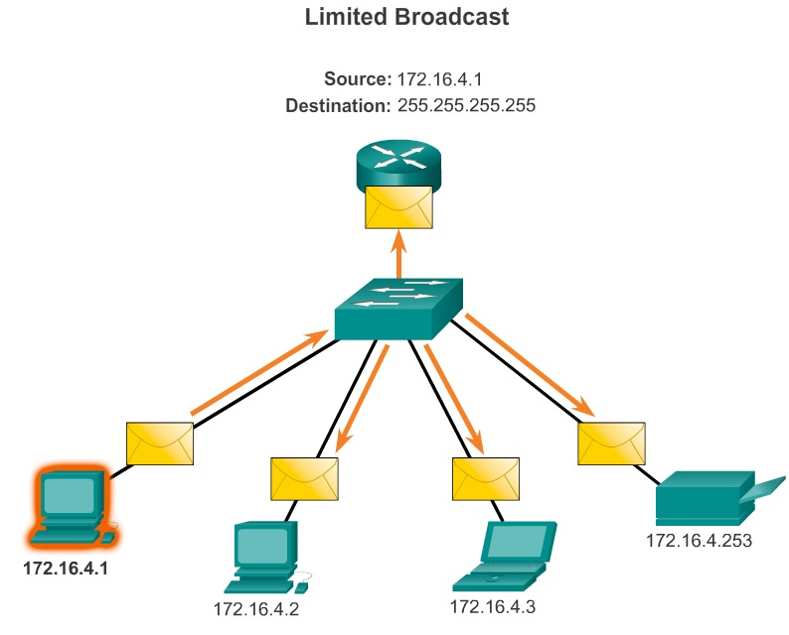
Subnetting
Subnetting can reduce overall network traffic and improve network performance.

Slide 16
Subnetting
A router is necessary for devices on different subnets to communicate. Devices on a subnet use the router interface attached to their LAN as their default gateway.
Traffic cannot be forwarded between subnets without the use of a router. Every interface on the router must have an IPv4 host address that belongs to the network or subnet to which the router interface is connected.
Planning network subnets requires examination of both the needs of an organization’s network usage, and how the subnets will be structured.

Slide 17
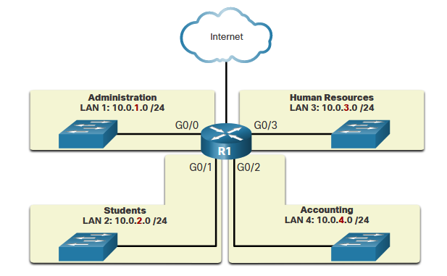
Subnetting

Slide 18
Subnetting
The address plan includes deciding the needs for each subnet in terms of size, how many hosts per subnet, how host addresses will be assigned, which hosts will require static IP addresses and which hosts can use DHCP for obtaining their addressing information.
Two very important factors that will lead to the determination of which private address block is required, are the number of subnets required and the maximum number of hosts needed per subnet.
Number of subnet = 2^{borrowbit}
Number of usable host = 2^{hostbit} - 2

Slide 19
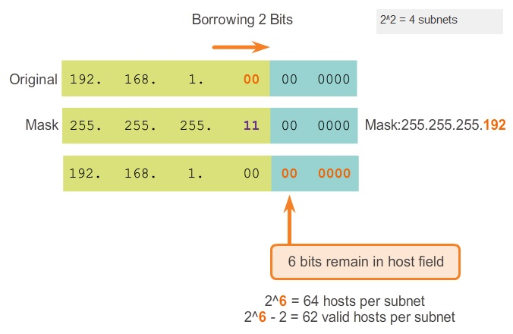
Subnetting

Slide 20
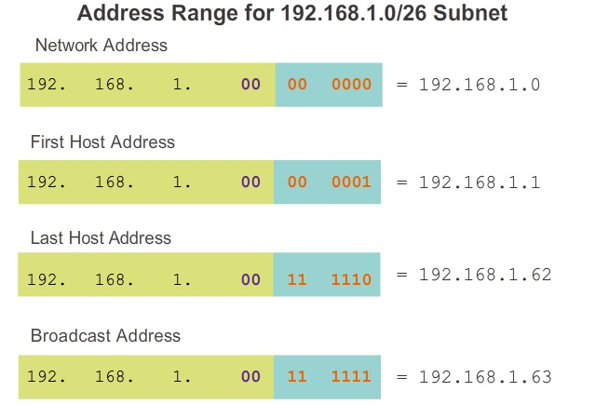
Subnetting

Slide 21
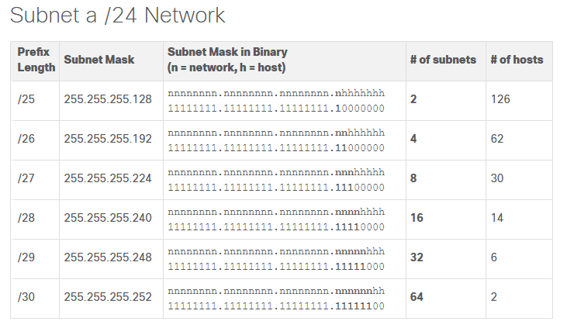
Subnetting

Slide 22
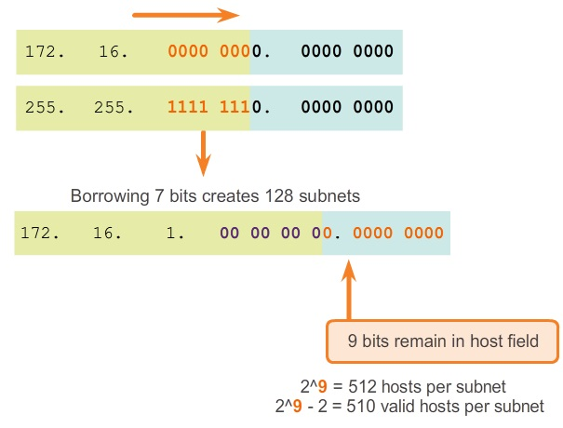
Subnetting

Slide 23
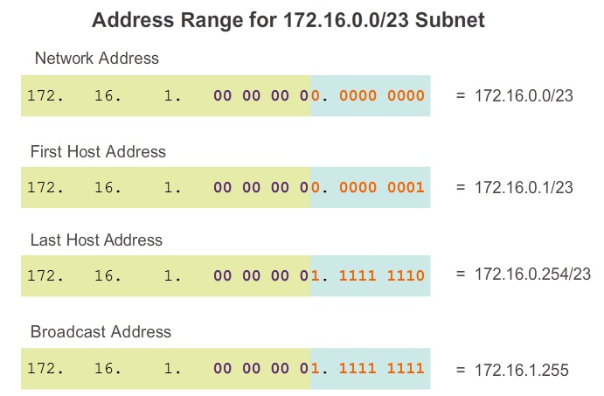
Subnetting

Slide 24
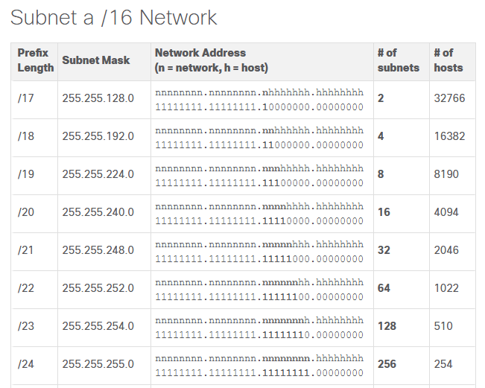
Subnetting

Slide 25
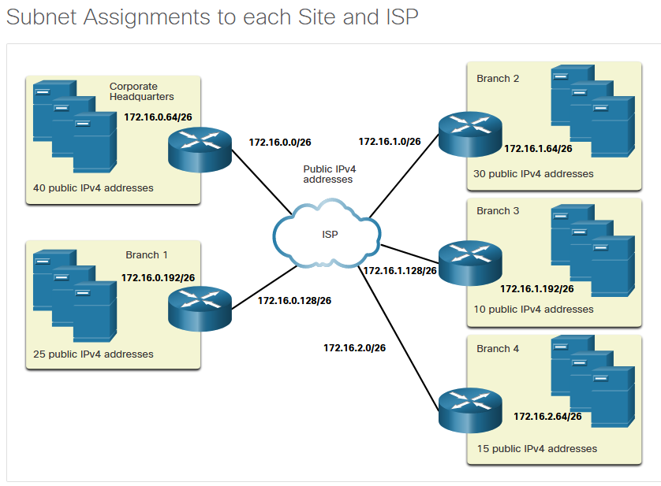
Subnetting

Slide 26
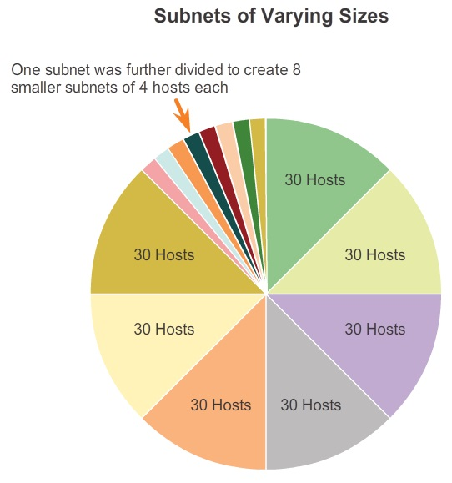
Subnetting
Subnetting a subnet, or using Variable Length Subnet Mask (VLSM), was designed to avoid wasting addresses.

Slide 27
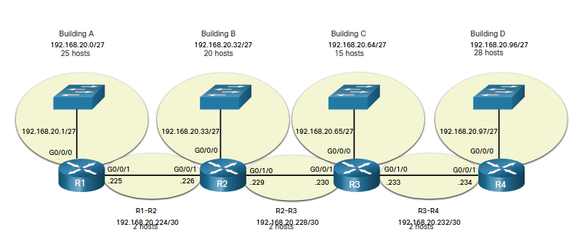
Subnetting

Slide 28
Subnetting
There are three primary considerations when planning address allocation.
  Preventing Duplication of Addresses - Each host in an internetwork must have a unique address.
  Providing and Controlling Access - Some hosts, such as servers, provide resources to internal hosts as well as to external hosts. Servers and peripherals should have a predictable static IP address.
  Monitoring Security and Performance - Similarly, the security and performance of network hosts and the network as a whole must be monitored. (Intermediary devices)

